Slide 1
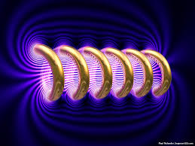





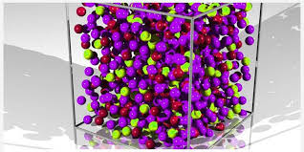
Engineering Physics
PHY-109
Quantum Mechanics-2
ELECTROMAGNETIC THEORY
QUANTUM MECHANICS
LASER
WAVES
Dr. Jeeban Pd Gewali
Department of Physics
Lovely Professional University
Phagwara, Punjab-144411
SOLID STATE PHYSICS
FIBER OPTICS

Slide 2
Syllabus
Need of quantum mechanics, photoelectric effect, concept of de Broglie matter waves, wavelength of matter waves in different forms.
Heisenberg uncertainty principle, concept of phase velocity and group velocity (qualitative),
Wave function and its significance, Schrodinger time dependent and independent equation
Particle in a box

Slide 3
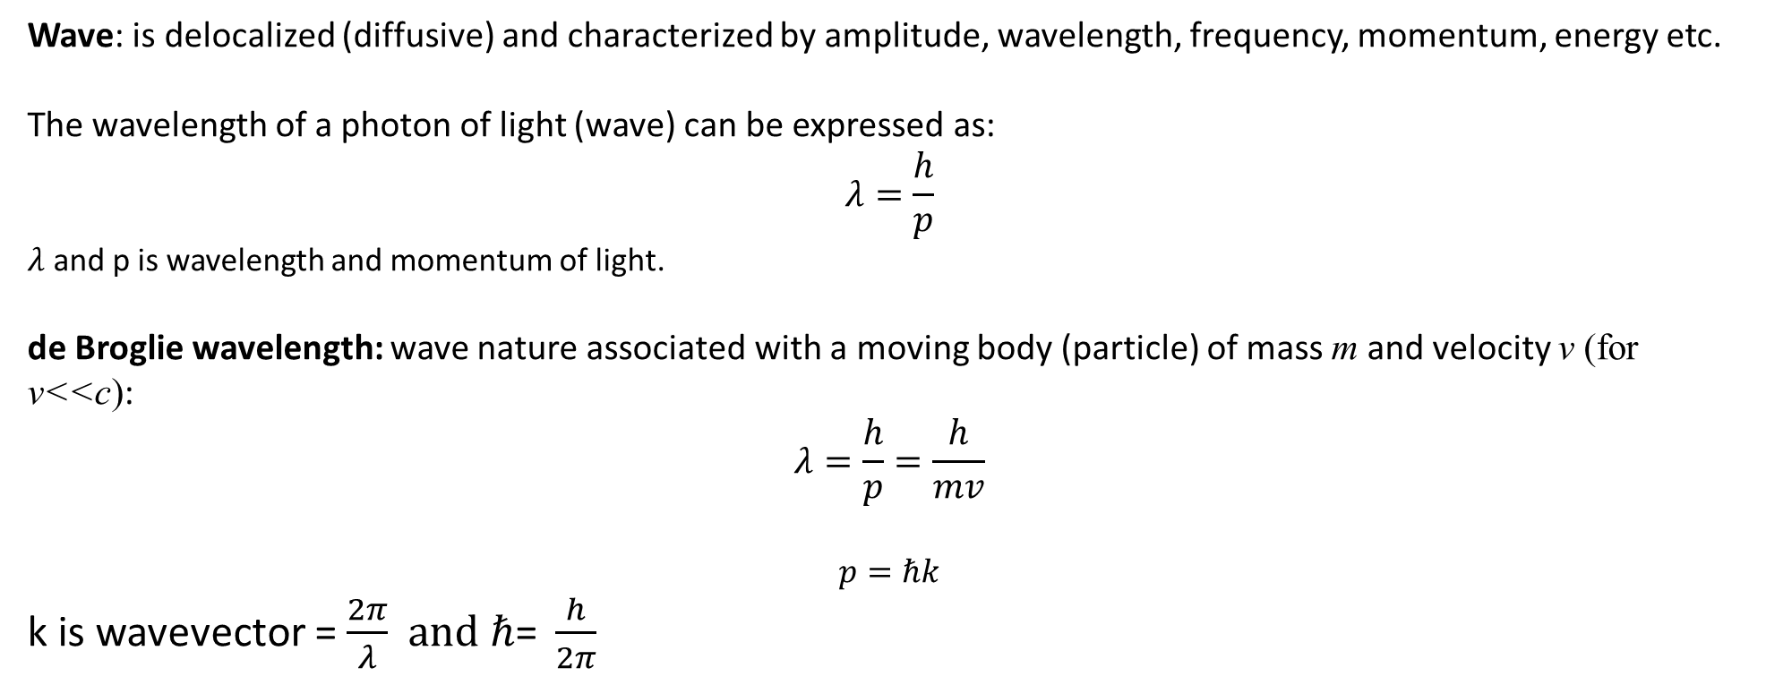
Wave Nature of particle
Wave: is delocalized (diffusive) and characterized by amplitude, wavelength, frequency, momentum, energy etc.
The wavelength of a photon of light (wave) can be expressed as:
$$λ=\frac{h}{p}$$
$λ$ and p is wavelength and momentum of light.
de Broglie wavelength: wave nature associated with a moving body (particle) of mass m and velocity v (for v<<c):
$$λ=\frac{h}{p}=\frac{h}{mv}$$
$$p=ℏk$$
k is wavevector = $\frac{2π}{λ}$$and ℏ\text{= }\frac{h}{2π}$

Slide 4
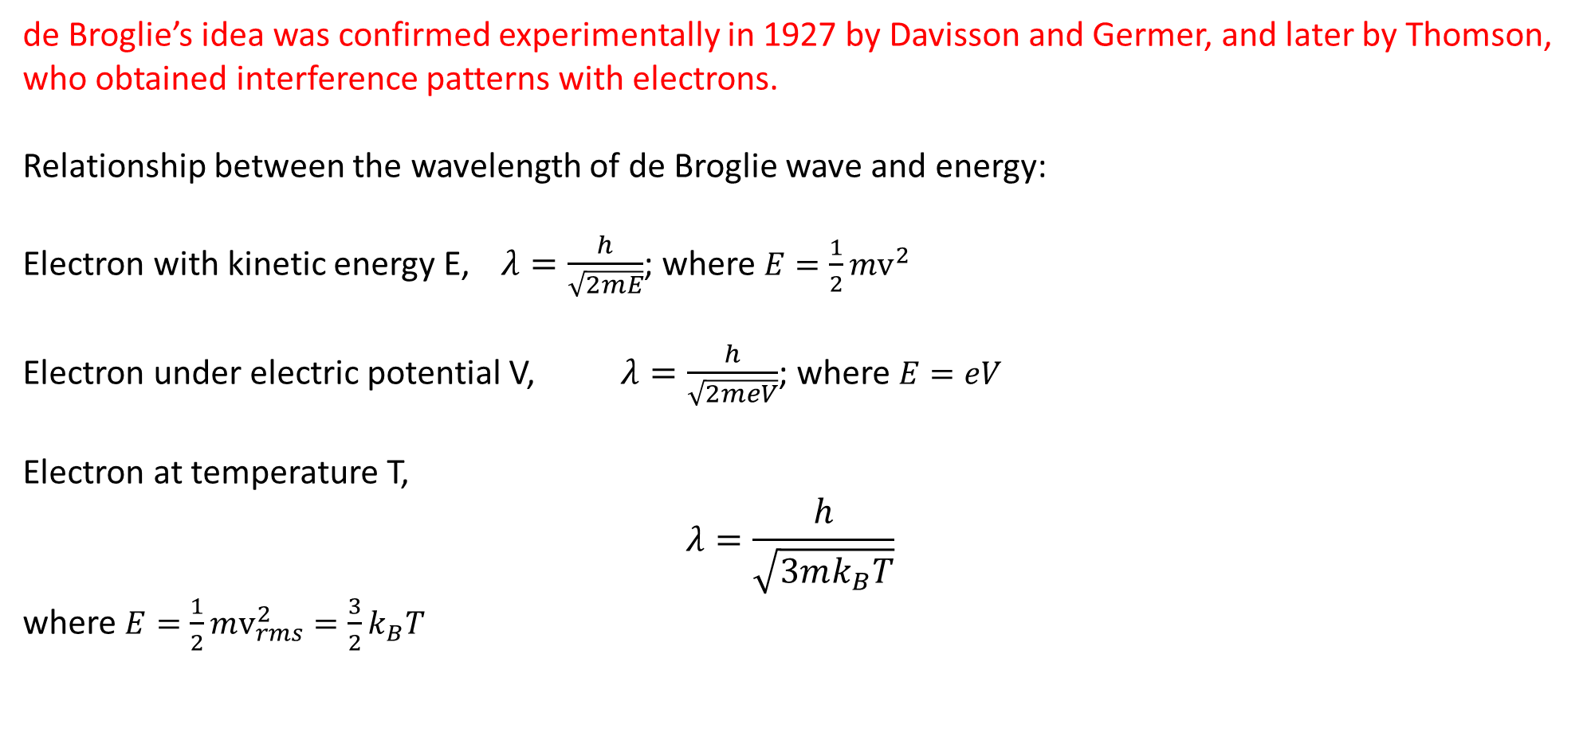
de Broglie’s idea was confirmed experimentally in 1927 by Davisson and Germer, and later by Thomson, who obtained interference patterns with electrons.
Relationship between the wavelength of de Broglie wave and energy:
Electron with kinetic energy E, $λ=\frac{h}{\sqrt{2mE}}$; where $E=\frac{1}{2}mv^{2}$
Electron under electric potential V, $λ=\frac{h}{\sqrt{2meV}}$; where $E=eV$
Electron at temperature T,
$$λ=\frac{h}{\sqrt{3mk_{B}T}}$$
where $E=\frac{1}{2}mv_{rms}^{2}=\frac{3}{2}k_{B}T$

Slide 5
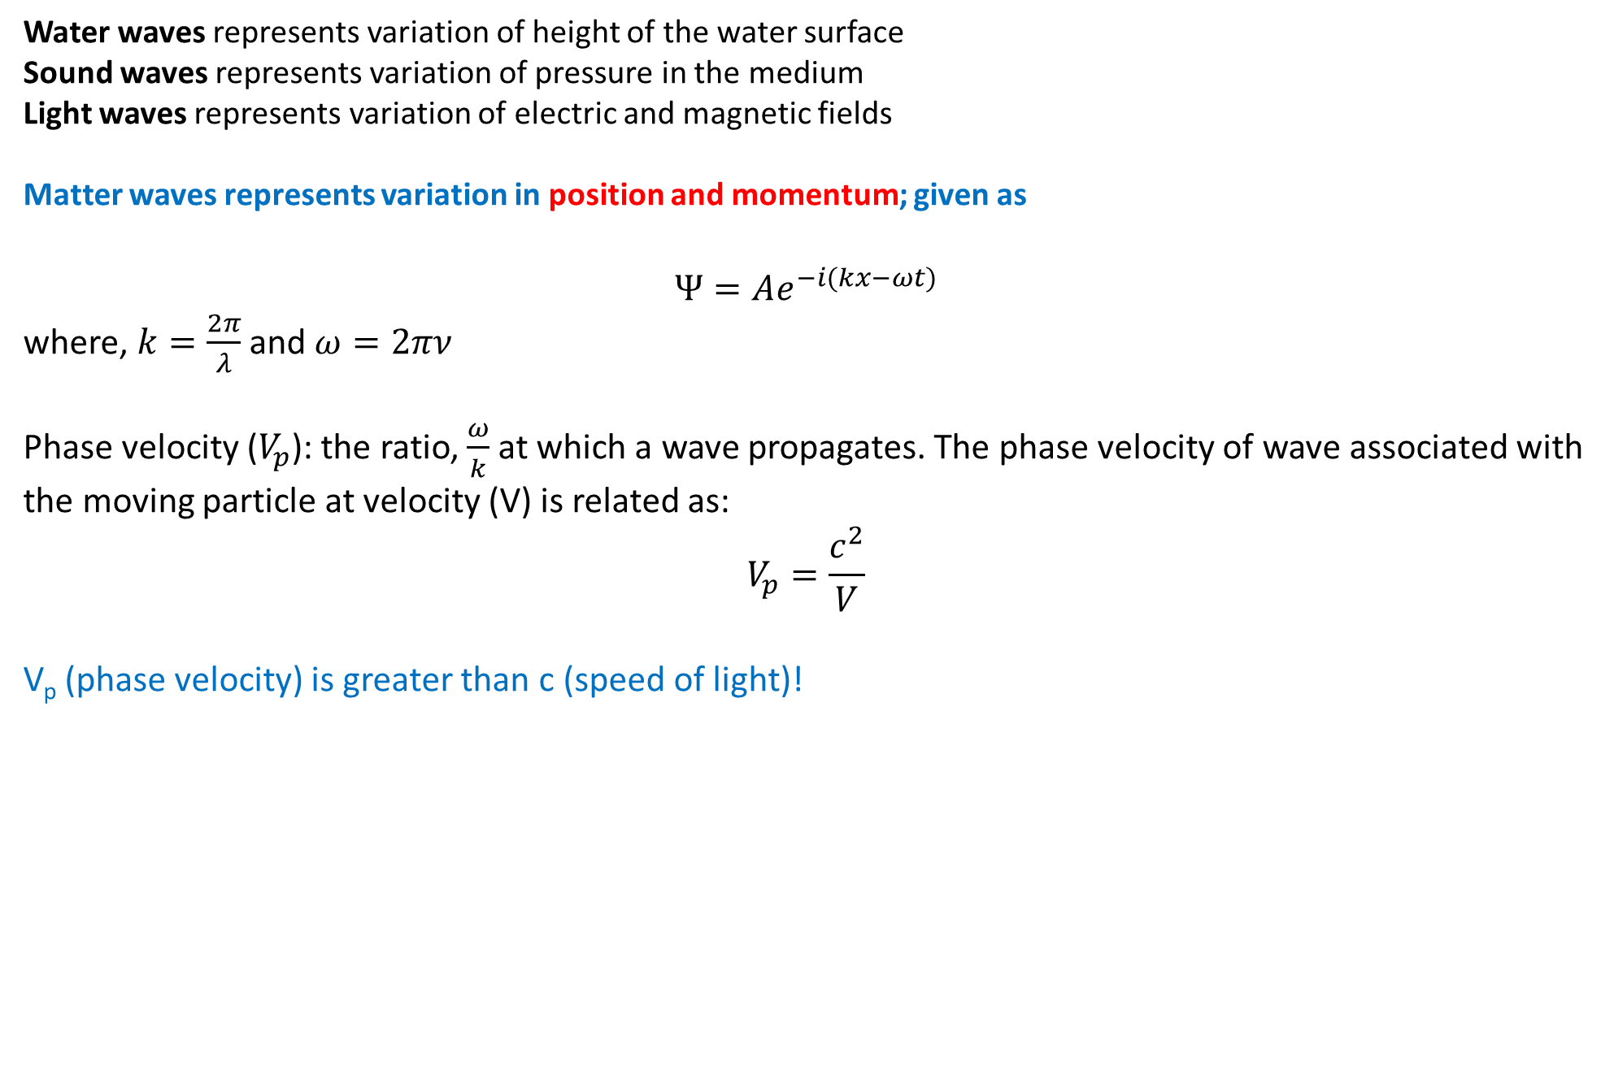
de Broglie waves (matter waves)
Water waves representsvariation of height of the water surface
Sound waves represents variation of pressure in the medium
Light waves represents variation of electric and magnetic fields
Matter waves represents variation in position and momentum; given as
$$Ψ=Ae^{−i(kx−ωt)}$$
where, $k=\frac{2π}{λ}$ and $ω=2πν$
Phase velocity ($V_{p}$): the ratio, $\frac{ω}{k}$at which a wave propagates. The phase velocity of wave associated with the moving particle at velocity (V) is related as:
$$V_{p}=\frac{c^{2}}{V}$$
V_{p} (phase velocity) is greater than c (speed of light)!

Slide 6
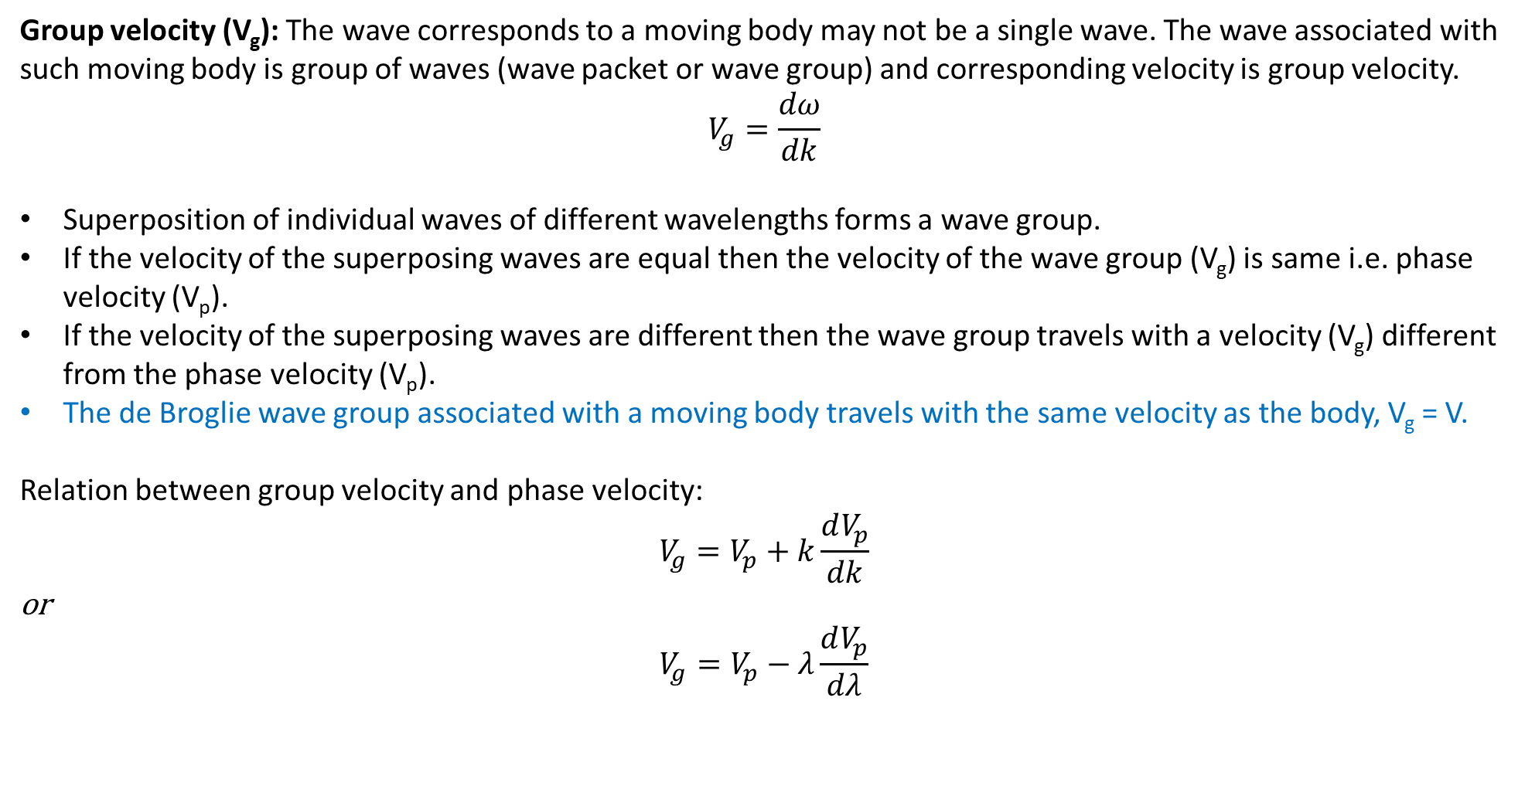
Group velocity (V_{g}): The wave corresponds to a moving body may not be a single wave. The wave associated with such moving body is group of waves (wave packet or wave group) and corresponding velocity is group velocity.
$$V_{g}=\frac{dω}{dk}$$
Superposition of individual waves of different wavelengths forms a wave group.
If the velocity of the superposing waves are equal then the velocity of the wave group (V_{g}) is same i.e. phase velocity (V_{p}).
If the velocity of the superposing waves are different then the wave group travels with a velocity (V_{g}) different from the phase velocity (V_{p}).
The de Broglie wave group associated with a moving body travels with the same velocity as the body, V_{g} = V.
Relation between group velocity and phase velocity:
$$V_{g}=V_{p}+k\frac{dV_{p}}{dk}$$
or
$$V_{g}=V_{p}−λ\frac{dV_{p}}{dλ}$$

Slide 7
Heisenberg’s Uncertainty Principle
Precise determination of position and momentum simultaneously of a moving particle is not possible.
It has a fundamental limit.
The position of the narrow de Broglie wave can be measured precisely but wavelength (and consequently momentum) can not be measured precisely
The wavelength (and consequently momentum) of de Broglie wave can be measured precisely but position can not be measured precisely

Slide 8
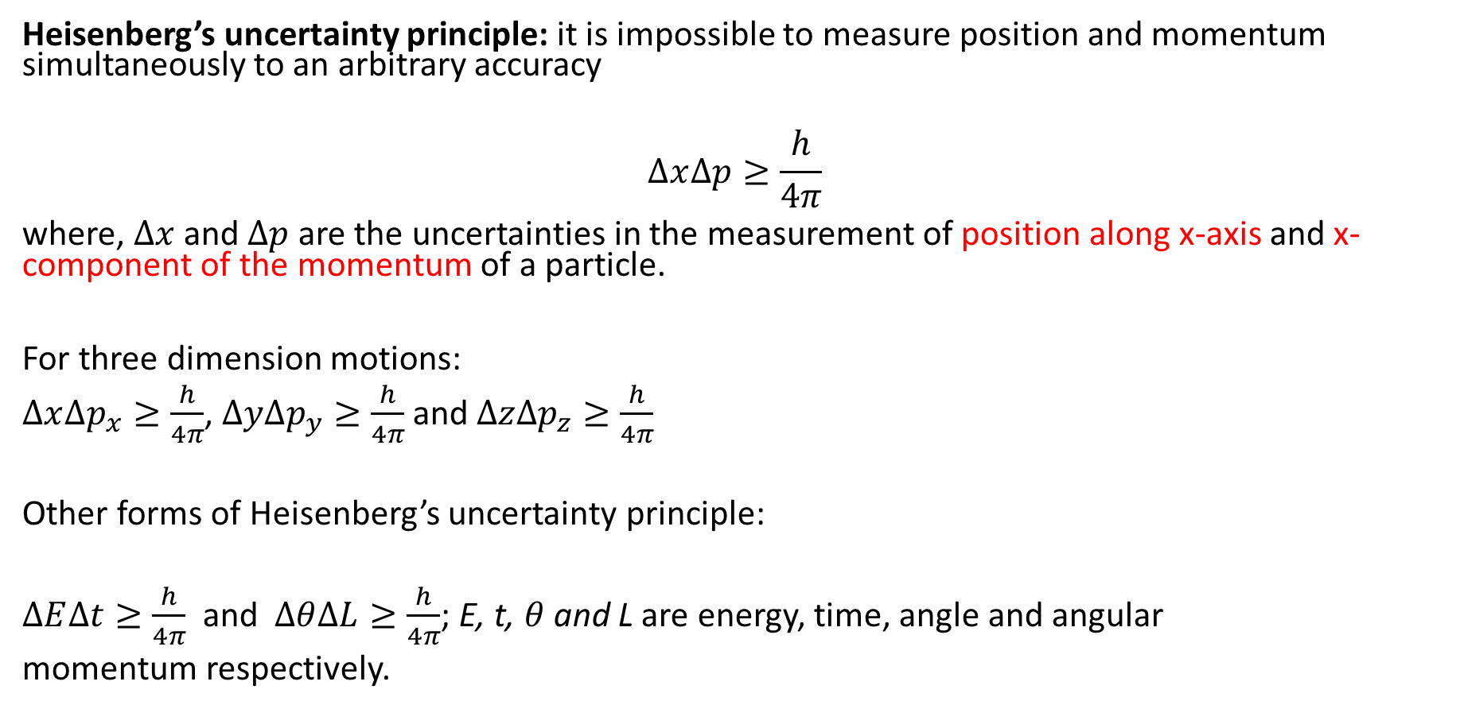
Heisenberg’s uncertainty principle: it is impossible to measure position and momentum simultaneously to an arbitrary accuracy
$$∆x∆p≥\frac{h}{4π}$$
where, $∆x$ and $∆p$ are the uncertainties in the measurement of position along x-axis and x-component of the momentum of a particle.
For three dimension motions:
$∆x∆p_{x}≥\frac{h}{4π}$, $∆y∆p_{y}≥\frac{h}{4π}$ and $∆z∆p_{z}≥\frac{h}{4π}$
Other forms of Heisenberg’s uncertainty principle:
$∆E∆t≥\frac{h}{4π}$ and $∆θ∆L≥\frac{h}{4π}$; E, t, $θ$ and L are energy, time, angle and angular
momentum respectively.

Slide 9
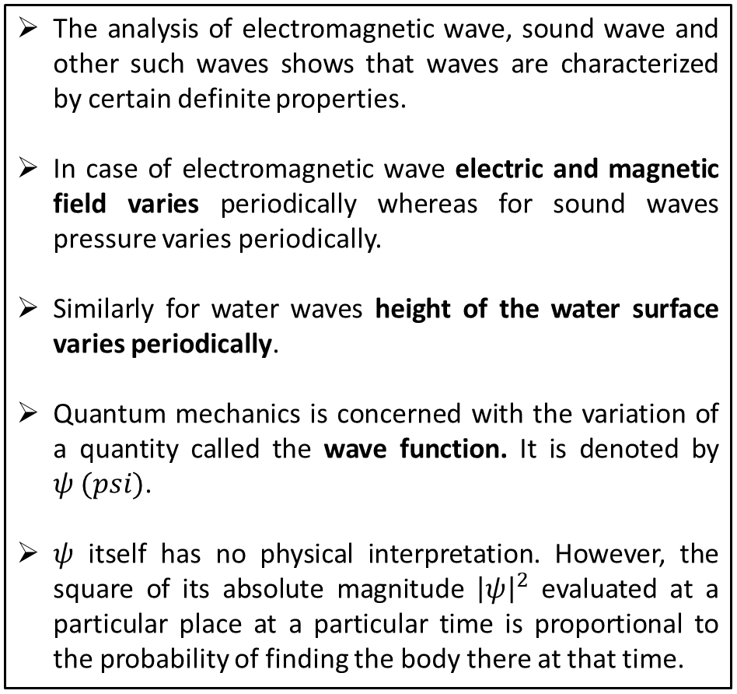
Wave functions
The analysis of electromagnetic wave, sound wave and other such waves shows that waves are characterized by certain definite properties.
In case of electromagnetic wave electric and magnetic field varies periodically whereas for sound waves pressure varies periodically.
Similarly for water waves height of the water surface varies periodically.
Quantum mechanics is concerned with the variation of a quantity called the wave function. It is denoted by $ψ (psi)$.
$ψ$ itself has no physical interpretation. However, the square of its absolute magnitude ${\left|ψ\right|}^{2}$ evaluated at a particular place at a particular time is proportional to the probability of finding the body there at that time.
Comparison of classical and quantum harmonic oscillator conceptions for a single spin-less particle. The two processes differ greatly. The classical process (A–B) is represented as the motion of a particle along a trajectory. The quantum process (C–H) has no such trajectory. Rather, it is represented as a wave; here, the vertical axis shows the real part (blue) and imaginary part (red) of the wave function. Panels (C–F) show four different standing-wave solutions of the Schrödinger equation. Panels (G–H) further show two different wave functions that are solutions of the Schrödinger equation but not standing waves

Slide 10
Wave equation and probability
https://www.youtube.com/watch?v=OFwskHrtYQ4

Slide 11
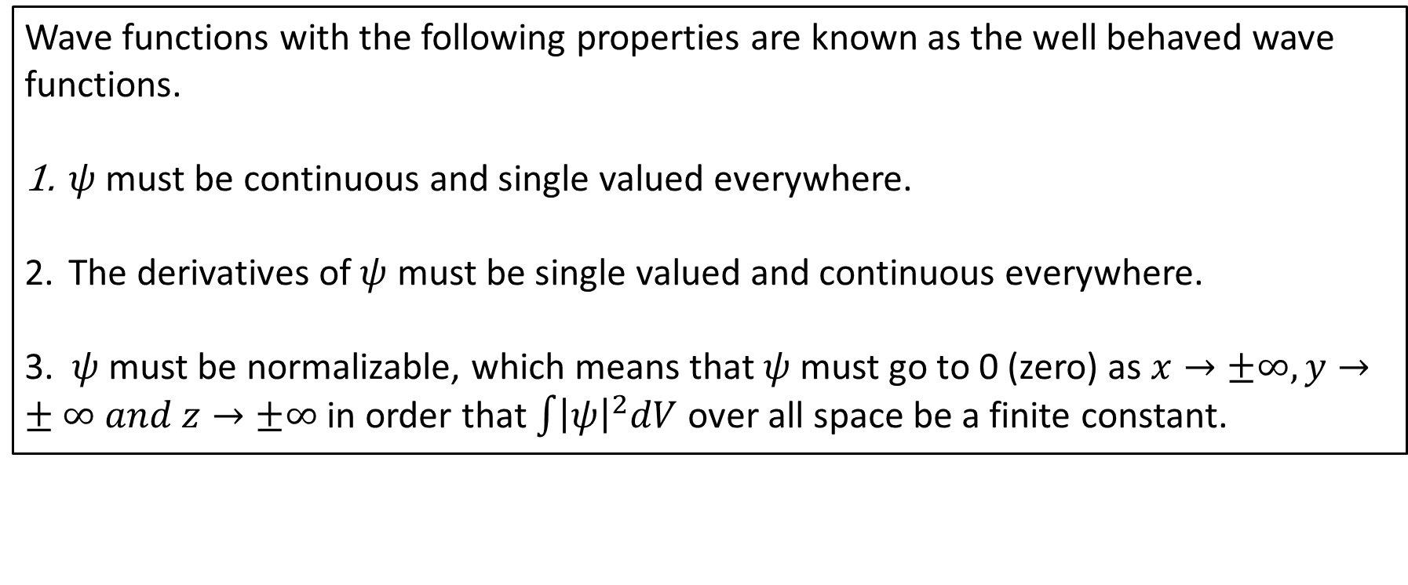
Well Behaved Wave functions
Wave functions with the following properties are known as the well behaved wave functions.
$ψ$ must be continuous and single valued everywhere.
The derivatives of $ψ$ must be single valued and continuous everywhere.
3. $ψ$ must be normalizable, which means that $ψ$ must go to 0 (zero) as $x→±∞,y→±∞ and z→±∞$ in order that $\int{{\left|ψ\right|}^{2}dV}$ over all space be a finite constant.

Slide 12
Wave function
Boundary conditions
In order to avoid infinite probabilities, the wave function must be finite everywhere.
In order to avoid multiple values of the probability, the wave function must be single valued.
For finite potentials, the wave function and its derivative must be continuous. This is required because the second-order derivative term in the wave equation must be single valued. (There are exceptions to this rule when V is infinite.)
In order to normalize the wave functions, they must approach zero as x approaches infinity.
Solutions that do not satisfy these properties do not generally correspond to physically realizable circumstances.

Slide 13
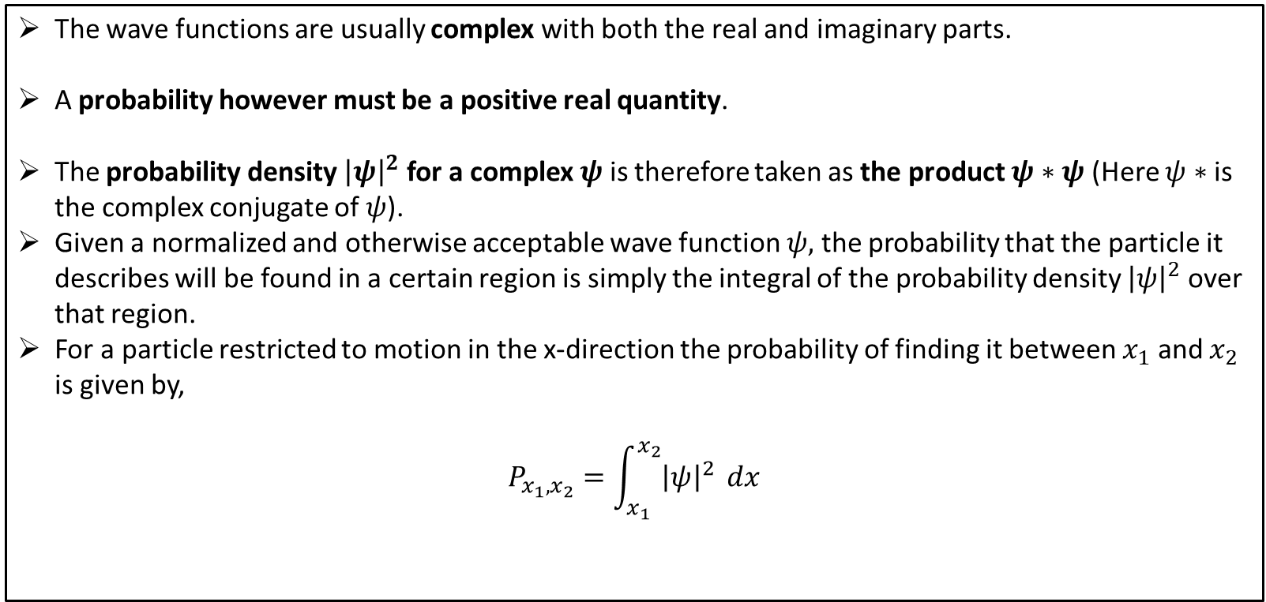
Probability
The wave functions are usually complex with both the real and imaginary parts.
A probability however must be a positive real quantity.
The probability density ${\left|ψ\right|}^{2}$ for a complex $ψ$is therefore taken as the product $ψ∗ψ$(Here $ψ∗$ is the complex conjugate of $ψ$).
Given a normalized and otherwise acceptable wave function $ψ,$ the probability that the particle it describes will be found in a certain region is simply the integral of the probability density ${\left|ψ\right|}^{2}$ over that region.
For a particle restricted to motion in the x-direction the probability of finding it between $x_{1}$ and $x_{2}$ is given by,
$$P_{x_{1},x_{2}}=\int_{x_{1}}^{x_{2}}{{\left|ψ\right|}^{2}} dx$$

Slide 14
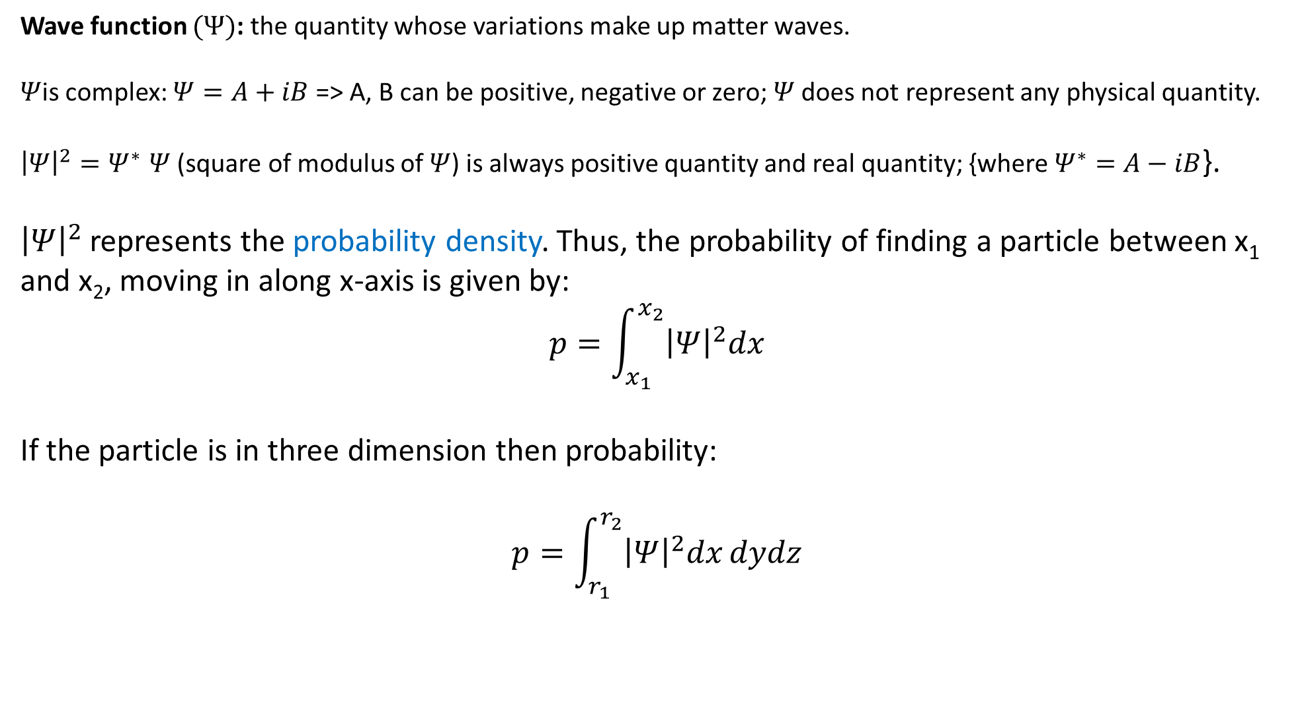
Properties of wave function
Wave function $(Ψ)$: the quantity whose variations make up matter waves.
$Ψ$is complex: $Ψ=A+iB$ => A, B can be positive, negative or zero; $Ψ$does not represent any physical quantity.
${\left|Ψ\right|}^{2}{=Ψ}^{∗}Ψ$ (square of modulus of $Ψ$) is always positive quantity and real quantity; {where$Ψ^{∗}=A−iB$}.
${\left|Ψ\right|}^{2}$ represents the probability density. Thus, the probability of finding a particle between x₁ and x₂, moving in along x-axis is given by:
$$p=\int_{x_{1}}^{x_{2}}{{\left|Ψ\right|}^{2}dx}$$
If the particle is in three dimension then probability:
$$p=\int_{r_{1}}^{r_{2}}{{\left|Ψ\right|}^{2}dx}dydz$$

Slide 15
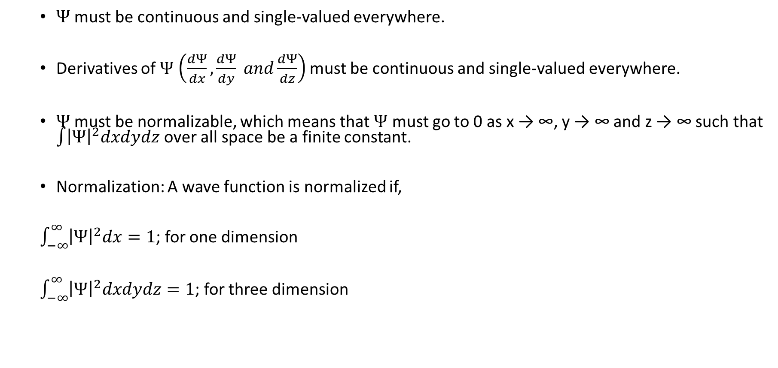
Properties of a well behaved wave function
$Ψ$ must be continuous and single-valued everywhere.
Derivatives of $Ψ$$\left(\frac{dΨ}{dx},\frac{dΨ}{dy} and\frac{dΨ}{dz}\right)$ must be continuous and single-valued everywhere.
$Ψ$ must be normalizable, which means that $Ψ$ must go to 0 as x → ∞, y → ∞ and z → ∞ such that $\int{{\left|Ψ\right|}^{2}dxdydz}$ over all space be a finite constant.
Normalization: A wave function is normalized if,
$\int_{−∞}^{∞}{{\left|Ψ\right|}^{2}dx}=1$; for one dimension
$\int_{−∞}^{∞}{{\left|Ψ\right|}^{2}dxdydz}=1$; for three dimension

Slide 16
Examples of wave function
Well-behaved wave functions
Not well-behaved wave functions

Slide 17
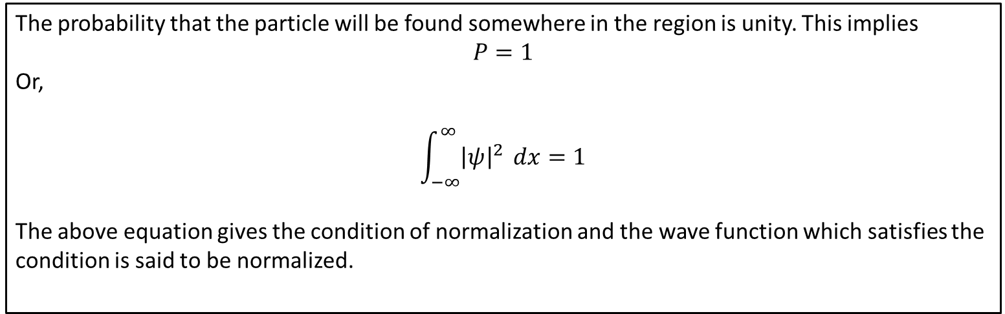
Normalization
The probability that the particle will be found somewhere in the region is unity. This implies
$$P=1$$
Or,
$$\int_{−∞}^{∞}{{\left|ψ\right|}^{2}} dx=1$$
The above equation gives the condition of normalization and the wave function which satisfies the condition is said to be normalized.

Slide 18
Schrodinger Time dependent and Independent Form
The time dependent form of the Schrödinger equation depends on the physical situation. The most general form is the time-dependent Schrödinger equation, which gives a description of a system evolving with time.
The time-independent Schrödinger equation is the equation describing stationary states. The time-independent Schrödinger equation predicts that wave functions can form standing waves, called stationary states (also called "orbitals", as in atomic orbitals or molecular orbitals). These states are important in their own right, and if the stationary states are classified and understood, then it becomes easier to solve the time-dependent Schrödinger equation for any state.
https://www.quora.com/What-is-the-real-difference-between-the-time-dependent-Schrodingers-equation-and-time-independent-equation

Slide 19
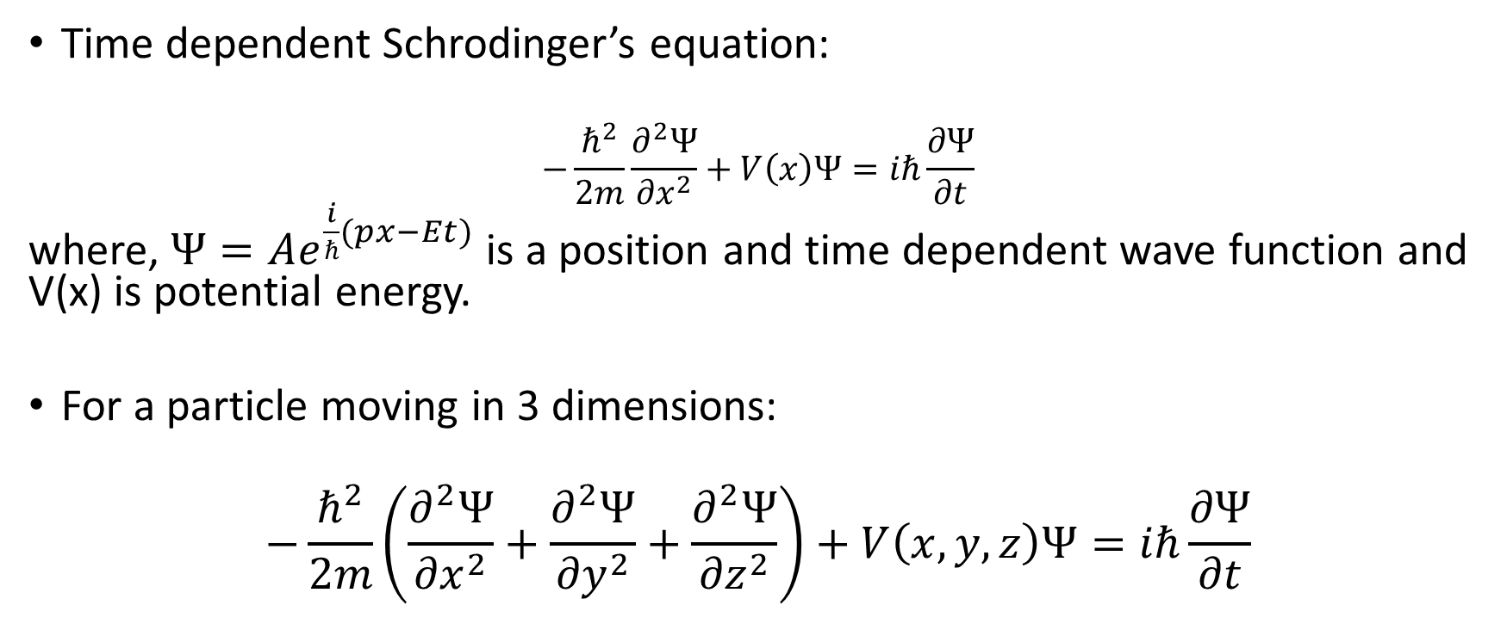
Schrodinger’s equation
Time dependent Schrodinger’s equation:
$$−\frac{ℏ^{2}}{2m}\frac{∂^{2}Ψ}{{∂x}^{2}}+V\left(x\right)Ψ=iℏ\frac{∂Ψ}{∂t}$$
where, $Ψ=Ae^{\frac{i}{ℏ}(px−Et)}$ is a position and time dependent wave function and V(x) is potential energy.
For a particle moving in 3 dimensions:
$$−\frac{ℏ^{2}}{2m}\left(\frac{∂^{2}Ψ}{{∂x}^{2}}+\frac{∂^{2}Ψ}{{∂y}^{2}}+\frac{∂^{2}Ψ}{{∂z}^{2}}\right)+V\left(x,y,z\right)Ψ=iℏ\frac{∂Ψ}{∂t}$$

Slide 20
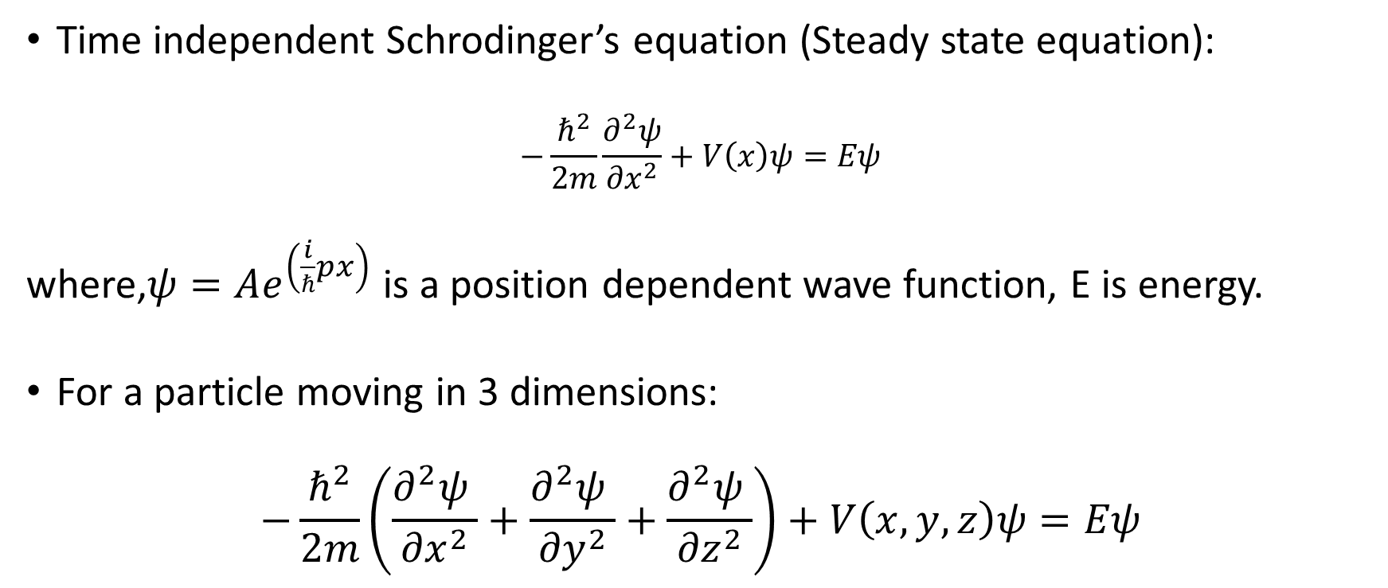
Time independent Schrodinger’s equation (Steady state equation):
$$−\frac{ℏ^{2}}{2m}\frac{∂^{2}ψ}{{∂x}^{2}}+V\left(x\right)ψ=Eψ$$
where,$ψ=Ae^{\left(\frac{i}{ℏ}px\right)}$ is a position dependent wave function, E is energy.
For a particle moving in 3 dimensions:
$$−\frac{ℏ^{2}}{2m}\left(\frac{∂^{2}ψ }{{∂x}^{2}}+\frac{∂^{2}ψ }{{∂y}^{2}}+\frac{∂^{2}ψ }{{∂z}^{2}}\right)+V\left(x,y,z\right)ψ=Eψ$$

Slide 21
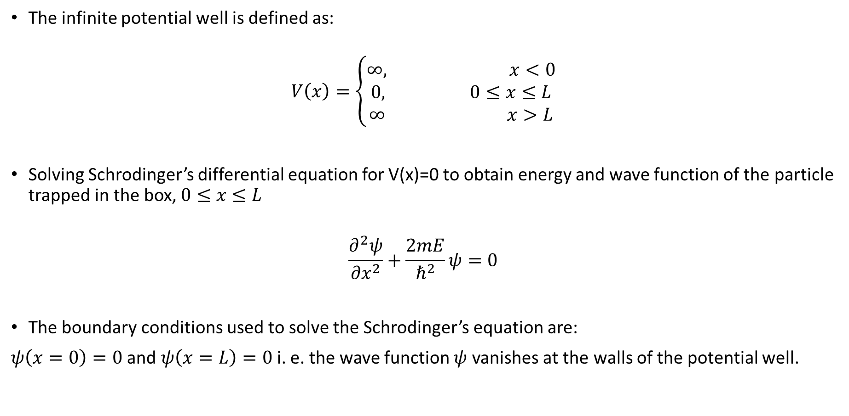
Particle in an infinite potential well (box)
The infinite potential well is defined as:
$$V\left(x\right)=\left\{\begin{aligned}∞, x<0 \\ 0, 0≤x≤L \\ ∞ x>L\end{aligned}\right.$$
Solving Schrodinger’s differential equation for V(x)=0 to obtain energy and wave function of the particle trapped in the box, $0≤x≤L$
$$\frac{∂^{2}ψ}{{∂x}^{2}}+\frac{2mE}{ℏ^{2}}ψ=0$$
The boundary conditions used to solve the Schrodinger’s equation are:
$ψ\left(x=0\right)=0$ and $ψ\left(x=L\right)=0$i. e. the wave function $ψ$ vanishes at the walls of the potential well.
Infinite potential well

Slide 22

The wave function of the particle is for nth state is given by:
$${ψ }_{n}=\sqrt{\frac{2}{L}}sin\left(\frac{nπx}{L}\right)$$
The energy of the particle is for nth state is given by:
$$E_{n}=\frac{n^{2}π^{2}ℏ^{2}}{2mL^{2}}$$
The momentum of the particle is for nth state is given by:
$$p_{n}=\frac{nπℏ}{L}$$
where n, m, L are quantum number, mass of the particle, length of the box.
The value of n is 1, 2, 3,…….

